Slide 1
Week 8 Numerical Simulation of Foams Presentation
By Tony Hau

Slide 2
Objective of this presentation section
To include some numerical simulations and relate them to my previous research

Slide 3




Main paper reference:
1. SAMoS Tutorial
2. Dynamics and stationary configurations of heterogeneous foams
Main technical reference:
https://www.youtube.com/watch?v=e_XwbflJ4UE
Paraview Tutorial

Slide 4
Simulation from Dynamics and stationary configurations of heterogeneous foams
Energy in this paper is represented as the total length of cells → we want to find a configuration (given initial volume constraint) that minimizes energy
Algorithm to search for this configuration is called auction dynamics

Slide 5
Result
Implication:
Plateau’s angle rule gives minimized configurations

Slide 6
Result (with number of cells from 2 to 21)
Implication:
Plateau’s angle rule gives minimized configurations

Slide 7
Result
Now, we try to add some area by perturbation and find the minimized configuration
T2 operation

Slide 8
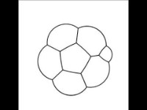
Evolution from a 6-foam to a 7-foam (T1 operation observed)

Slide 9
Implication
T1 and T2 operations are rearrangements that occur spontaneously so that the configuration has a minimized perimeter in 2D case (Remember that we do not assume the occurrence of T1 and T2 operations in this paper)
Plateau’s law(120 degree law) is followed because it gives minimized perimeter (true for bubbles n=2,…,21 in this paper)
In paper https://raw.githubusercontent.com/erleben/FOAM/master/doc/bondorf.17.master_thesis.pdf Simulation of Two-Dimensional Dry Foam Using a Vertex Model
we do T1 and T2 operations after iterations to find local minimum (120 degree Plateau’s Law and diffusion due to pressure difference(von Neumann’s law). This paper has justified the introduction of T1 and T2 operation.

Slide 10
Implication
T1 and T2 operations are rearrangements that occur spontaneously so that the configuration has a minimized perimeter in 2D case (Remember that we do not assume the occurrence of T1 and T2 operations in this paper)
Plateau’s law(120 degree law) is followed because it gives minimized perimeter (true for bubbles n=2,…,21 in this paper)
In paper https://raw.githubusercontent.com/erleben/FOAM/master/doc/bondorf.17.master_thesis.pdf Simulation of Two-Dimensional Dry Foam Using a Vertex Model
we do T1 and T2 operations after iterations to find local minimum (120 degree Plateau’s Law and diffusion due to pressure difference(von Neumann’s law). This paper has justified the introduction of T1 and T2 operation.

Slide 11
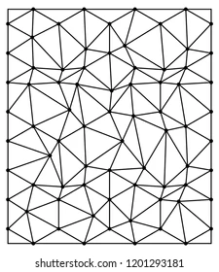
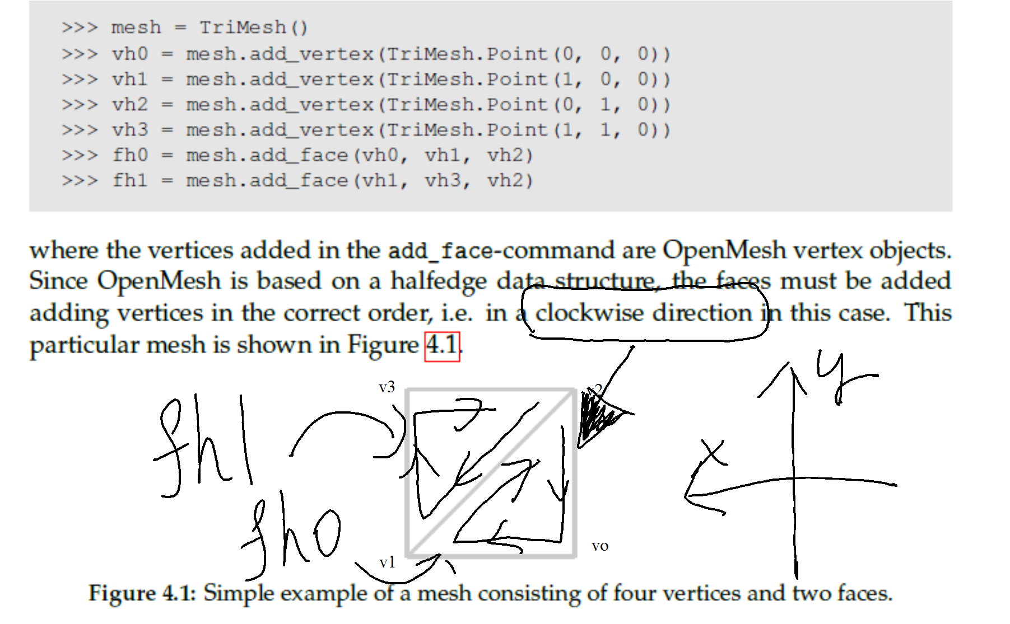

T1 operation – vertex
A triangle mesh
In this simulation (using OpenMesh Library), we represent a triangle mesh (can contain a lot of triangles) using an object : mesh= openmesh.Trimesh()

Slide 12
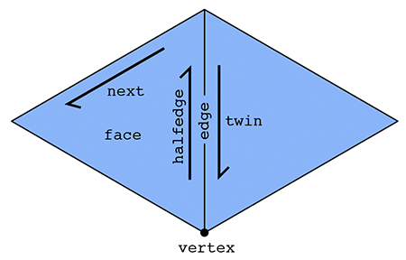
T1 operation – half-edges
The basic idea behind the halfedge is that, in addition to vertices, edges, and faces that make up a mesh, we also have an entity called a halfedge that is directional (like a vector)
Two halfedges are oppositely oriented. Each halfedge knows about the opposite halfedge, which we call its twin. It also knows about the next halfedge around its face, as well as its associated edge, face, and root vertex.
An outgoing halfedge (going out of the vertex)

Slide 13
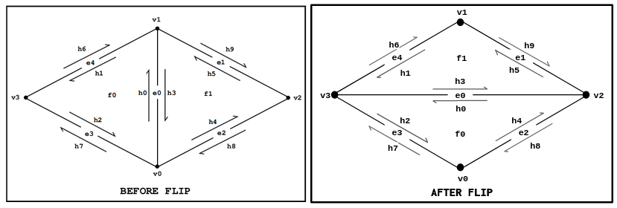
T1 operation – 2 phases of flipping half-edges
Phase 1: Collect elements
Phase 2: Reassign Elements

Slide 14
T1 operation – Phase 1

Slide 15
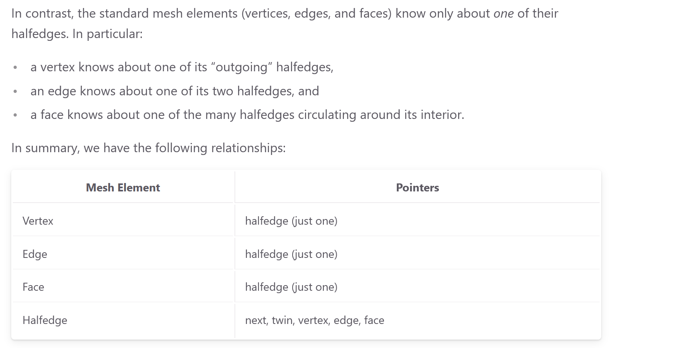
T1 operation – Phase 1
Notes:
I point to a half edge by referring to its affiliated edge

Slide 16
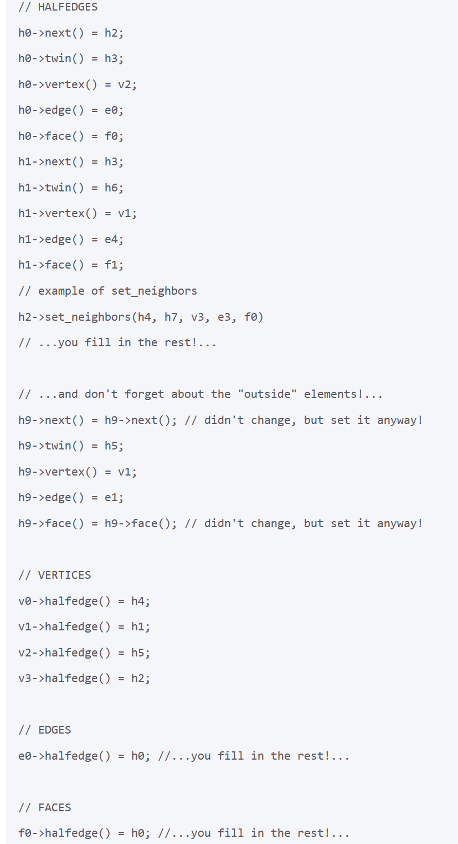
T1 operation – Phase 2
…Next, update the pointers for all the mesh elements that are affected by the edge operation. Be exhaustive! In other words, go ahead and specify every pointer for every element, even if it did not change.

Slide 17
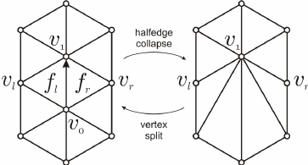
T2 operation – Phase 2
In OpenMesh, T2 is performed by deleting an outgoing half-edge from that vertex.
This half-edge deletion then automatically results in the deletion of three faces and the insertion of one face (two faces).
Assume that v_o’s pointer is the arrowed half-edge above
f_l and f_r are deleted because their pointers are the twins of the arrowed half-edge above

Slide 18
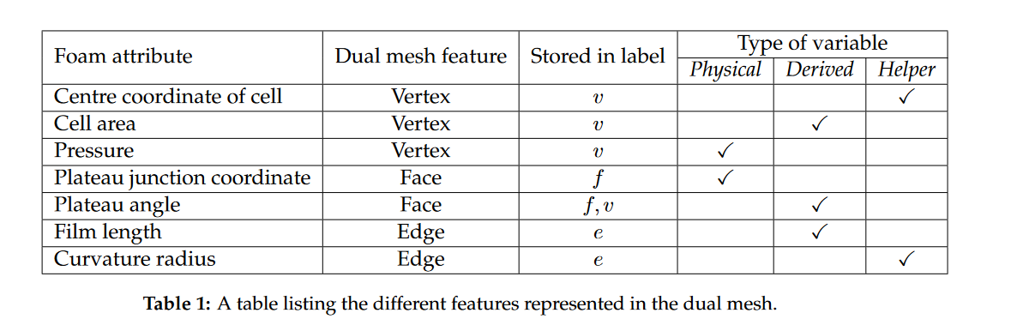
Helper, derived and physical quantities
To simulate Delaunay Triangulation, we only need to process the vertex handler such as vho as shown before, we do not need to know the centre coordinate of cell

Slide 19
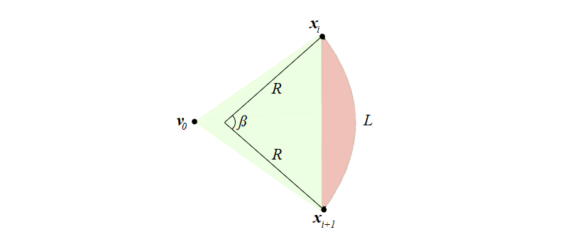
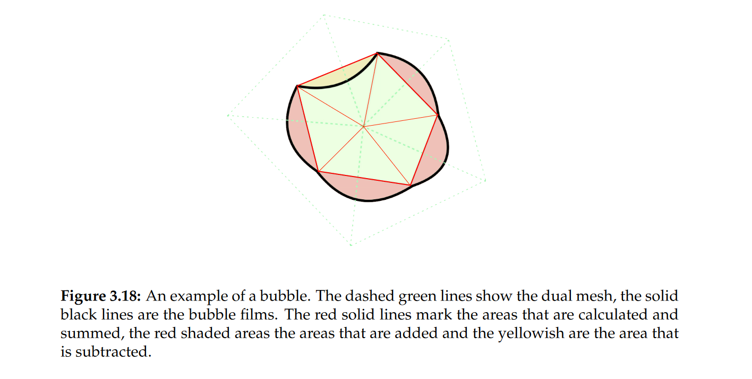
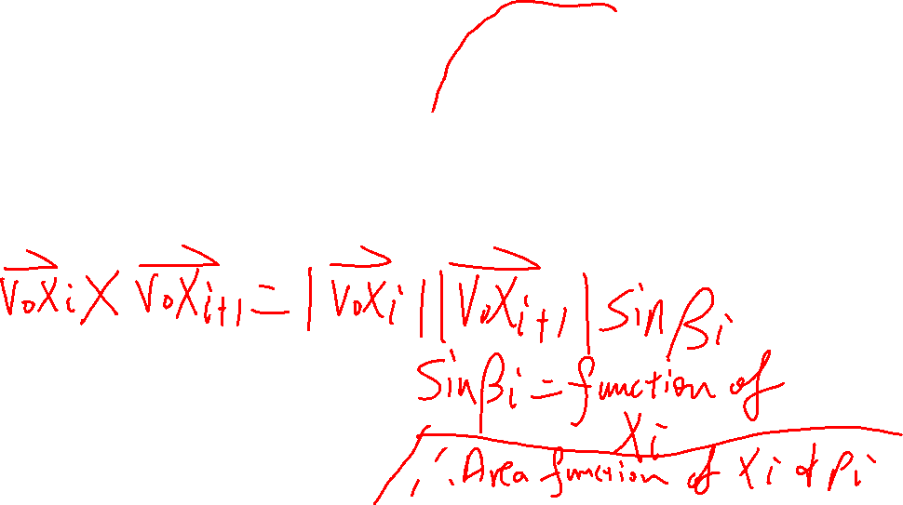
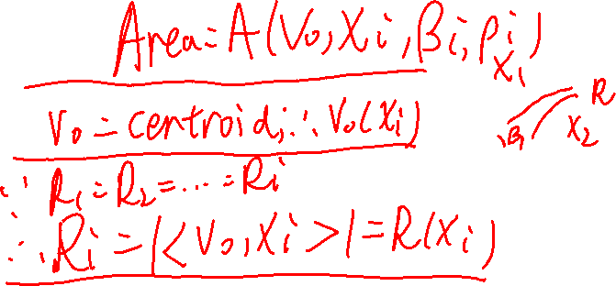
Bubble area – a derived property

Slide 20
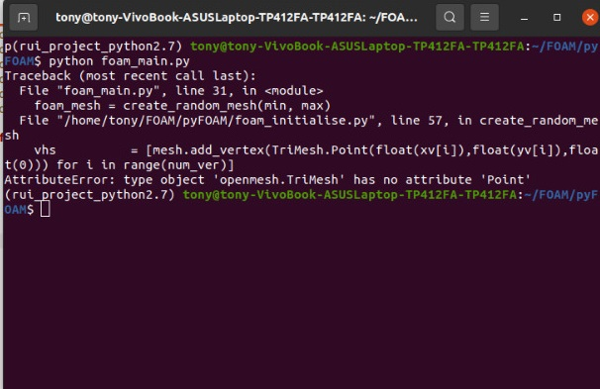
Technical issue encountered
conda install -c conda-forge openmesh-python is a different version of openmesh that is used by the author
Can run film_simulation.py but cannot run film_foam.py because film_simulation.py is a module file, not the main of the whole project
Error message when running foam_main.py using openmesh-python

Slide 21
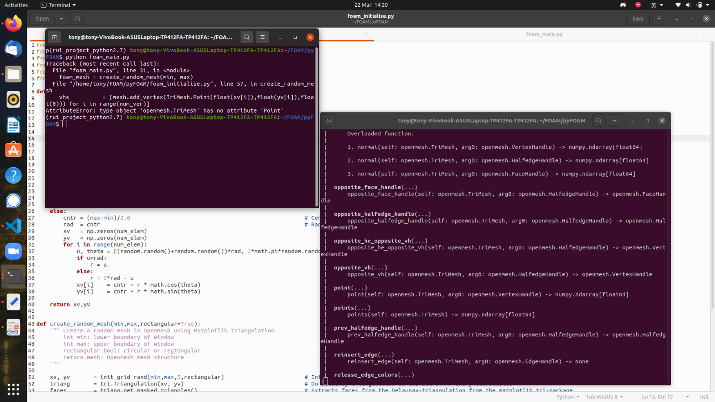
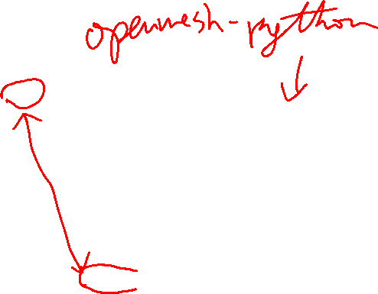
Technical issue encountered
My python version is 3.8. I entered help(openmesh.TriMesh) and find out that openmesh-python uses openmesh.TriMesh.point, not Point as in the author’s code → different version

Slide 22
Technical issue encountered
Only way is to try author’s instruction once more.
The author uses OpenMesh 4.2, should be python 2.7 as well, because his codes include some python 2.7 feature like
print “Hello” instead of print(“Hello”)
Official website for OpenMesh: https://www.graphics.rwth-aachen.de/software/openmesh/download/

Slide 23
Technical issue encountered
There is no OpenMesh 4.2 in the official website so I used OpenMesh 4.1. I downloaded the OpenMesh binary file OpenMesh 4.1 ( tar.gz ) for my linux terminal. Because this is a C++ extension, I need to download Boost.Python to link C++ extension to python → Followed this tutorial for my linux ubuntu
Boost.Python seems not to support python 2 and so I repeated the process with python 3.8 → still cannot install.
https://www.youtube.com/watch?v=p_OfzxyzM4s

